Slide 1
PHYS 304: Lecture 7 (Intro to) Quantum Mechanics
Sept-Dec 2021 Edition
Jeff Young
brimacombe Rm 278, young@phas.ubc.ca

Slide 2
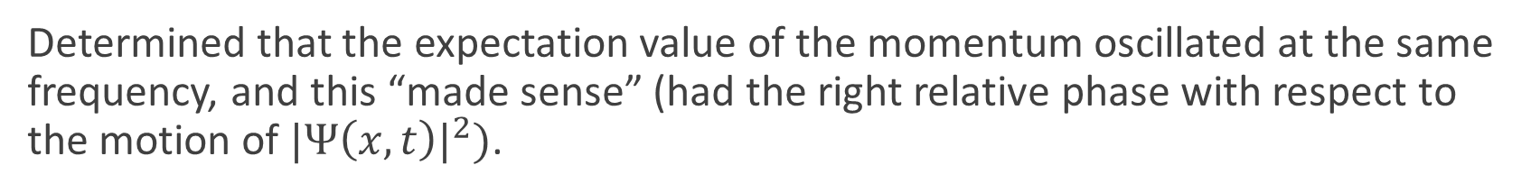
Review of Key points from last day
Explored the dynamical behaviour of an infinite square well wavefunction that is initially composed of an equally weighted simple sum of the two lowest stationary eigen states.
Found that the associated probability density “sloshed” periodically back and forth from side to side, with a frequency 3 times the ground state eigen frequency, “bouncing off the walls”. The period corresponds to the difference in eigen frequency between the two lowest level stationary states (essentially a beating effect).
Determined that the expectation value of the momentum oscillated at the same frequency, and this “made sense” (had the right relative phase with respect to the motion of ${|Ψ\left(x,t\right)|}^{2})$.
Notes:
NOTE: The expectation value of the momentum is NOT ZERO, and IT DEPENDS ON TIME. This is because our initial state is not proportional to a SINGLE eigen function of the time-independent SE, it MUST be expanded in more than a single eigen function.

Slide 3
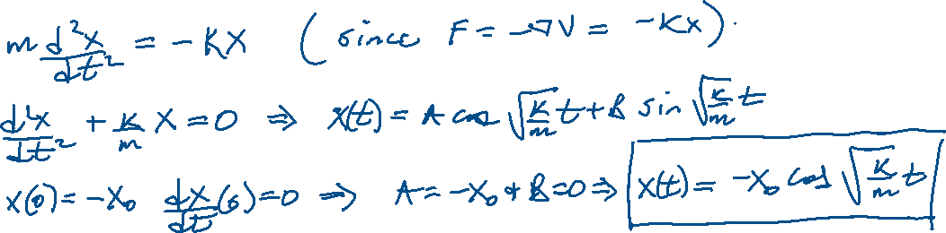

Today: The Harmonic Oscillator Potential Lecture 7, Activity 1: (TPS ~ 5 mins)
What is x(t) for a classical particle of mass m initially at rest at a position x=-x₀ in an harmonic potential V=kx²/2?
What is the maximum distance it ever travels away from the origin?
Notes:
Show handwritten calc
X0 and -xo

Slide 4
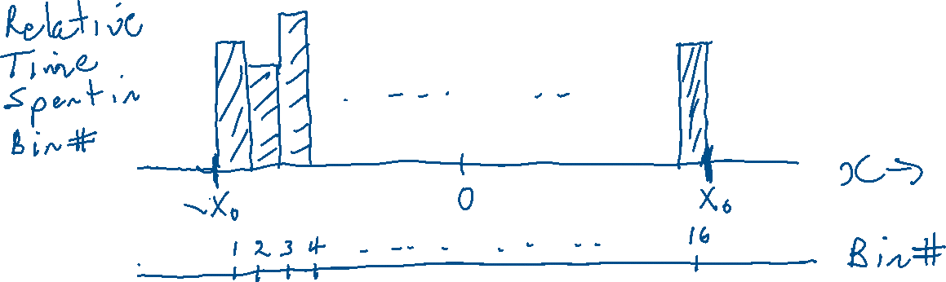
Harmonic Oscillator Potential Lecture 7, Activity 2: (Discussion only)
What is the probability distribution, P(x), for finding the particle at any position x (this is strictly a classical mechanics problem)?

Slide 5
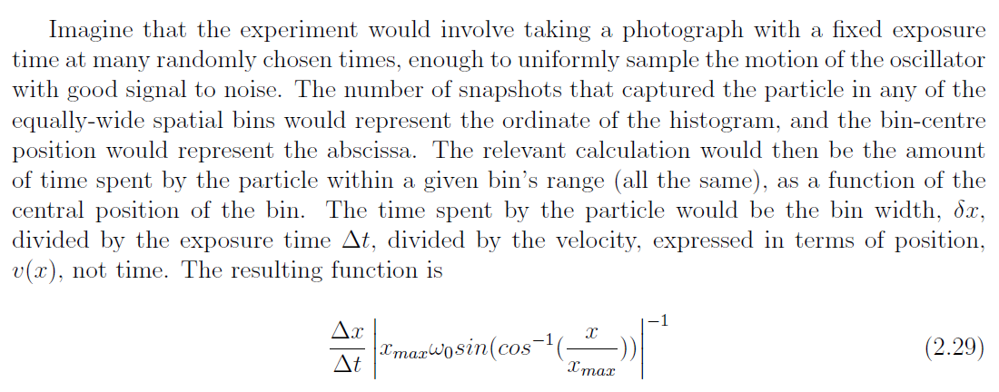
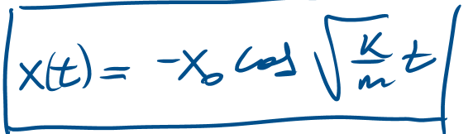
Harmonic Oscillator Potential Lecture 7, Activity 2: (Discussion only)
Δ x
Δ
Notes:
Dwell time = dx * dt/dx =dx/(v(x)), need to get v(x), not v(t)

Slide 6
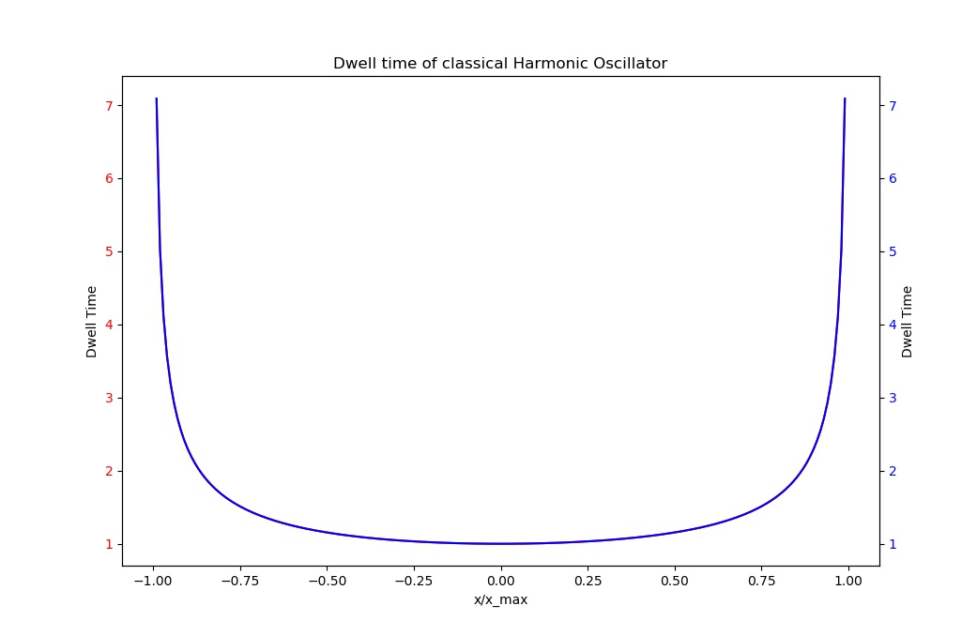
Harmonic Oscillator Potential Lecture 7, Activity 2: (Discussion only)
Δ
Notes:
Show plot from Harmonic_oscillator.py
Non-zero everywhere, spends more time near extremities (make sense?)

Slide 7
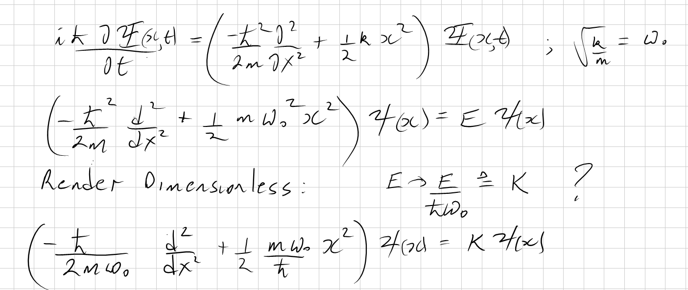
The Schrödinger Equation(s) Lecture 7, Activity 3: (TPS, ~ 5 min Breakout)
What are the full Schrödinger’s equation, and the time-independent Schrödinger’s equation for a quantum mechanical particle in this potential? Use dimensionless variables.
Notes:
Do by hand

Slide 8
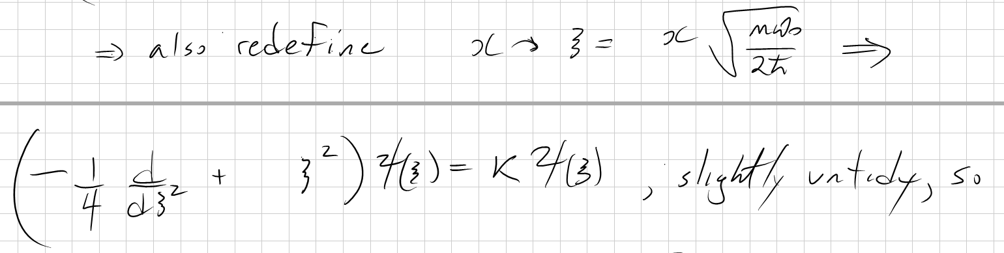
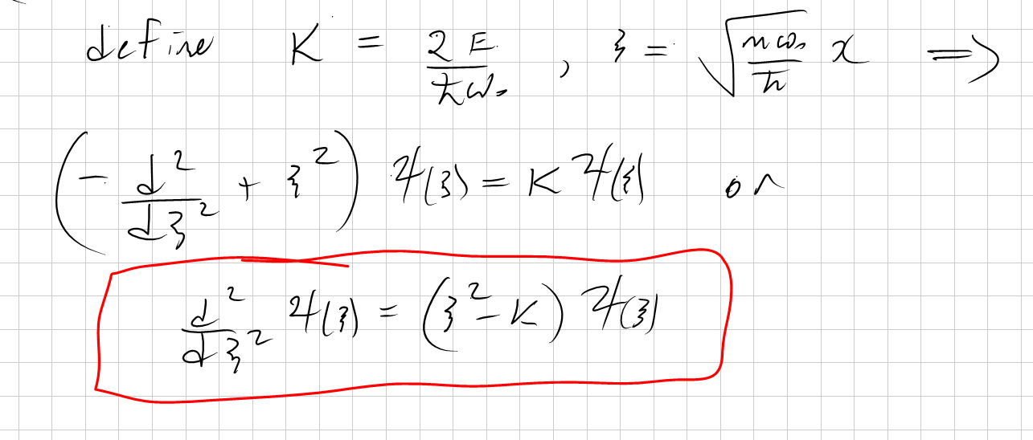
The Schrödinger Equation(s) Lecture 7, Activity 3: no breakouts

Slide 9

The Analytic, Brute Force Solution: (See my posted notes and text for the more elegant solution)
Four crucial steps from the dimensionless TISE, $\frac{d^{2}ψ(ξ)}{{dξ}^{2}}=(ξ^{2}−K)ψ(ξ)$ , to determining the allowed energy levels and eigen functions:
Find the function that satisfies the differential equation at large $ξ$ , namely $e^{±\frac{ξ^{2}}{2}}$ and then let $ψ\left(ξ\right)=h(ξ)$ $e^{−\frac{ξ^{2}}{2}}$
Substitute this back into the full TISE and get a new differential equation for $h(ξ)$ , namely $\frac{d^{2}h(ξ)}{{dξ}^{2}}−2ξ\frac{dh\left(ξ\right)}{dξ}+\left(K−1\right)h\left(ξ\right)=0$
Assume a power series expansion for $h(ξ)$ , $h\left(ξ\right)=\sum_{j=0}^{∞}{a_{j}ξ^{j}}$, equate coefficients of each power of $ξ$, to arrive at a recursion relationship: $a_{j+2}=\frac{(2j+1−K)}{(j+1)(j+2)}a_{j}$
Use BC that wavefunction has to go to zero at +/- infinity to realize that allowed solutions are defined by some maximum value of j, call it n, for which all higher expansion coefficients of $h(ξ)$ are zero.
Notes:
Why only assume the negative exponential form?

Slide 10
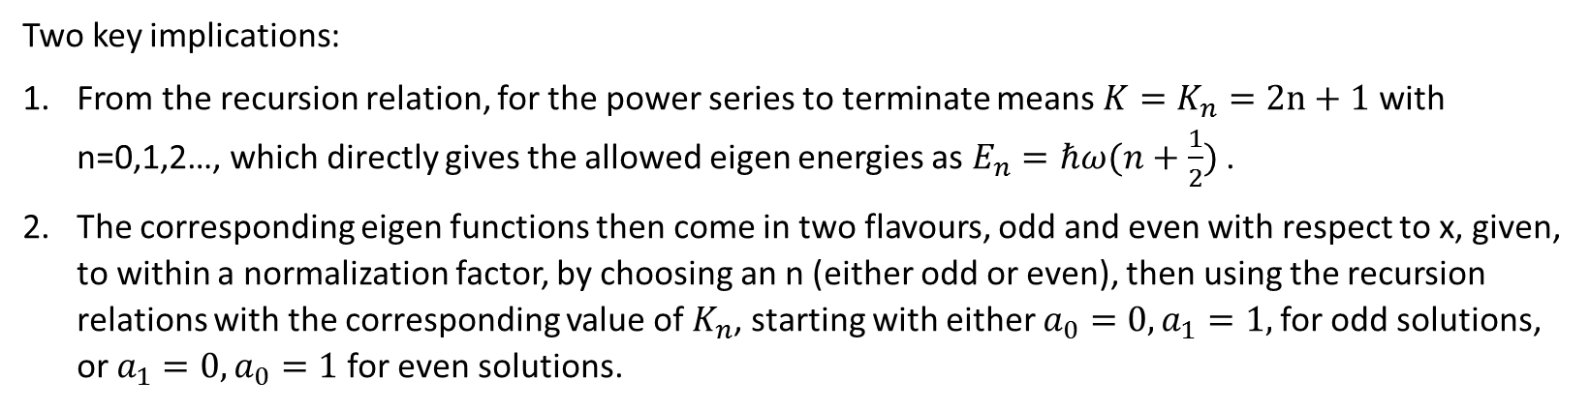
The Analytic, Brute Force Solution: (See my posted notes and text for the more elegant solution)
Two key implications:
From the recursion relation, for the power series to terminate means $K=K_{n}=2n+1$ with n=0,1,2…, which directly gives the allowed eigen energies as $E_{n}=ℏω(n+\frac{1}{2})$ .
The corresponding eigen functions then come in two flavours, odd and even with respect to x, given, to within a normalization factor, by choosing an n (either odd or even), then using the recursion relations with the corresponding value of $K_{n}$, starting with either $a_{0}=0,a_{1}=1,$for odd solutions, or $a_{1}=0,a_{0}=1$for even solutions.
Notes:
See text image

Slide 11
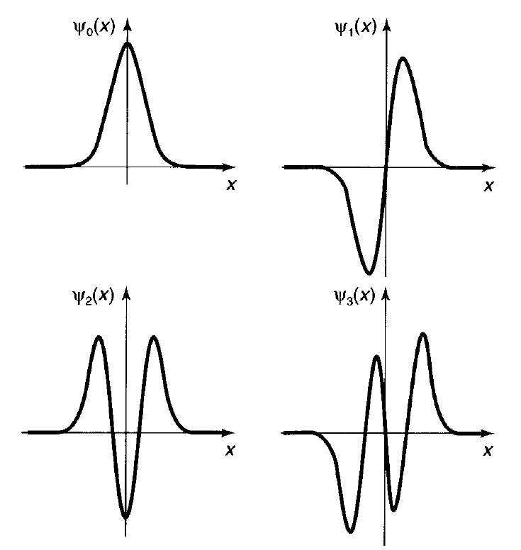
Quantitatively

Slide 12
Reflection: Lecture 7, Activity 4: (TPS ~ 3 mins)
What features of this wavefunction imply “non-classical” behaviour of the quantum mechanical particle in one of the lowest stationary states?
What features of these HO solutions differ and which are similar to the infinite square well stationary solutions?
Notes:
Extends beyond classical limits +/- x0
Probability of finding it at certain positions is zero
Quantized energy levels similar
Number of nodes = n
Separation of energy levels different
Separation of nodes not exactly periodic

Slide 13
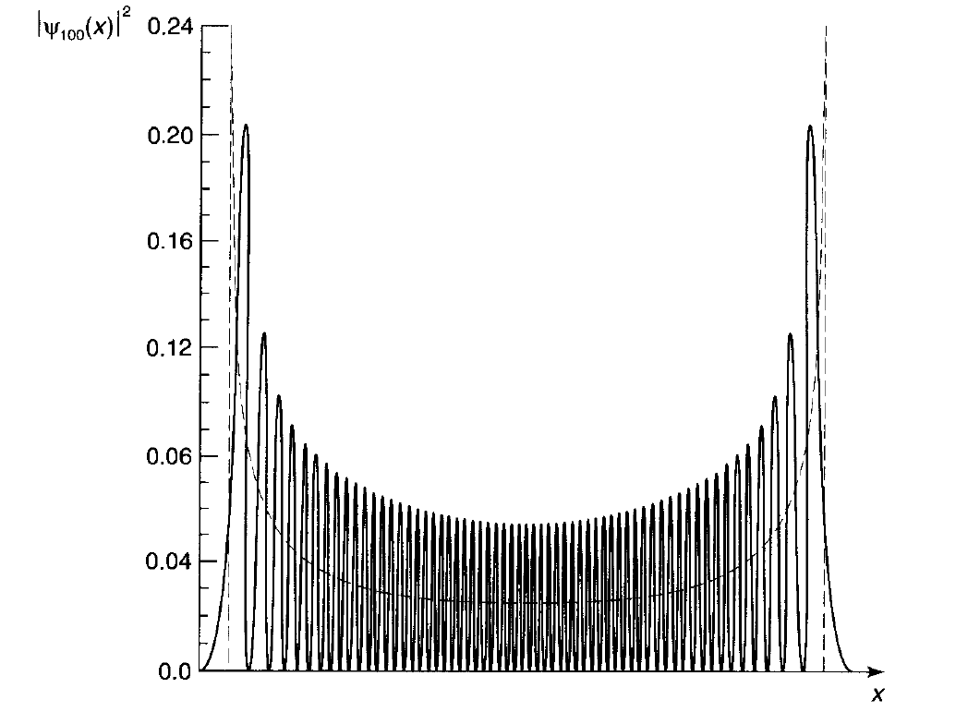
In what limit do the eigen states look “almost classical”?

Slide 14
Quiz

